Slide 1


Risky Business
Risk Management and Innovation in Public Services
Social Innovation
Stephen Osborne & Sophie Flemig University of Edinburgh

Slide 2
Research Questions
What is the current range of approaches to risk in innovation in public services across European countries
What are the key contingencies in the sustainability and
mental health sectors?
What are the current approaches for relevant stakeholders to engage in discussions about levels of risk for public service innovations?
How are these discussions translated into specific risk
management and governance models?
What are relevant principles for effective risk governance in innovation in public services?

Slide 3

Methodology and Data
EU FP7 “Learning from Innovation in Public Service Environments” research project (LIPSE)
Document Analysis
Websites
Internal communications
Risk management tools
Survey Analysis
800 contacts (200 per country, 657 responses in total
Case Study Analysis
4 case studies per country: 2 on mental health, 2 on sustainable
public services
6-8 interviews per case study
Total of 16 case studies and 104 interviews

Slide 4
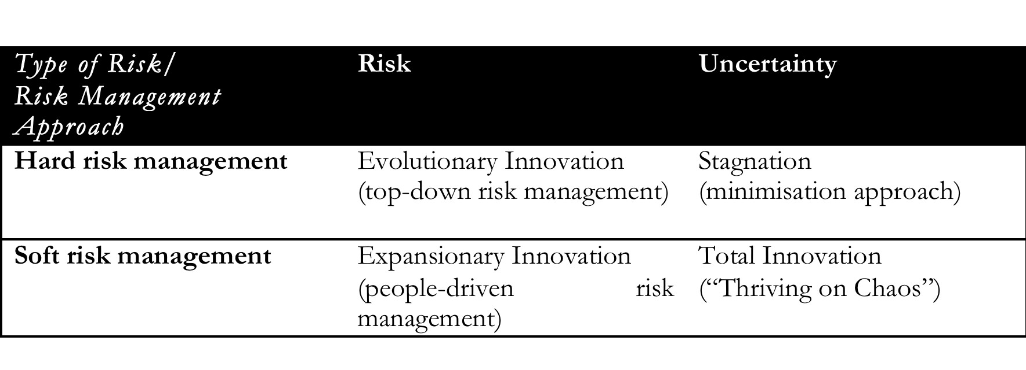
Theoretical Background

Slide 5
Survey Findings
Respondents showed difficulty in conceptualising risk
Managerial staff more aware of “risk management”
Risk management strategies still in place, described as “everyday activities”
Very few dedicated risk managers
Connection between risk and innovation affirmed but most often not incorporated in work and planning processes
In relation to innovation capacity, most often referred to …
Sustainability
Financial risks
Reputational risks
Regulatory/bureaucratic risks
Mental Health
Health and safety risks (service users)
Financial risks
More hard risk management in mental health, more soft tools in sustainability
Accounted for by top-down regulatory system in mental health

Slide 6
Interview Findings
Financial risks most important overall
Service user risk for mental health
Reputational risk for sustainability
Top-down risk management approaches, esp. in mental health, implementation driven by local stakeholders
Institutionally-driven risk management in sustainability
Driven by funding calls
Often minimise risk as part of funding contract
Innovation still precondition for new funding
Resulting tension leads many organisations to become more risk averse when it comes to innovation that is task/service driven

Slide 7




Comparative Findings
Italy
“all roads lead to lack of participation of the local community”
Engagement of local community as proactive risk management
Mostly non-profit organisations
Difference in risk management for innovations between associations and cooperatives
Netherlands
Innovation mostly bottom-up in sustainability, top-down in mental health
Few formal risk management strategies (new, small organisations in sustainability, more surprising in larger, established mental health
organisations)
Slovakia
Strong public sector presence in both mental health and sustainability
Explicitly acknowledged PPPs as ambivalent (more risk than source of innovation, esp.
partnerships with local government)
UK
Decentralised risk management standards, esp. in mental health (informal sharing)
Regulatory/bureaucratic risk management seen as stifling innovation in
environmental sustainability

Slide 8

Conclusions
Policy
Recognising the role of regulation and institutional frameworks rather than
an understanding of innovation processes as driver for risk management
Move away from minimisation of risk if policy is meant to encourage innovation
Encourage/provide follow-up funding to make innovations sustainable
(funding risk paramount!)
Practice
Acknowledge effects of risk management on innovation
in funding calls (i.e. level of detail)
Raise awareness and acknowledge risk as core of the process
of innovation
Make connection explicit within organisation
Differentiate types of risk and adjust hard/soft risk management approaches accordingly

Slide 9

Questions? Answers.

